Slide 1
Function name
Input
Processing
Output
Side effects

Slide 2
mean
c(1, 5, 6)
Add values and divide by the length of the vector
4

Slide 3
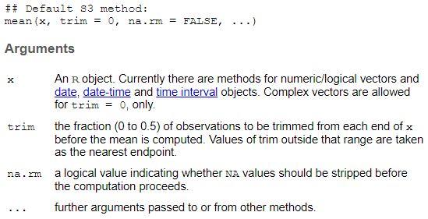

Slide 4
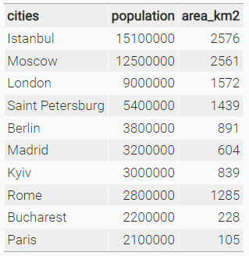
character
numeric

Slide 5
character
numeric

Slide 8





Data structure
Import
Tidy
Visualise
Transform

Slide 9
Data structure
Import
Tidy
Transform
Visualise

Slide 10
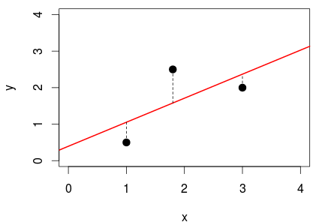

Slide 11
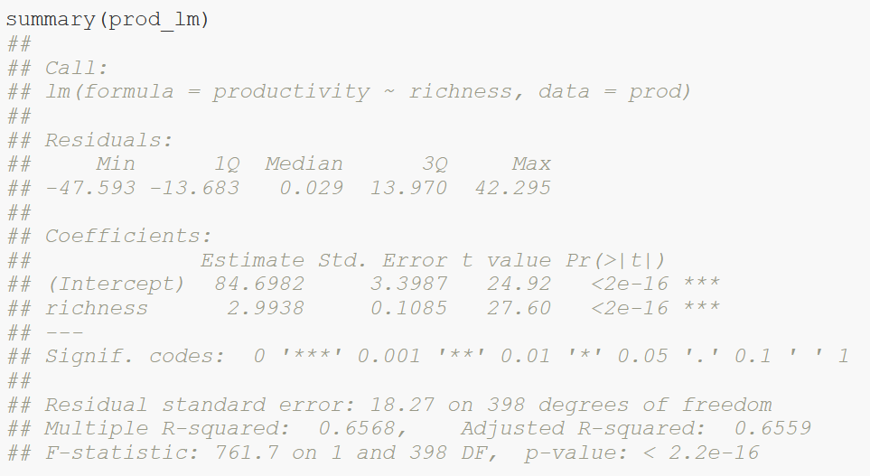
Calculated model
Distribution of residuals (errors)

Slide 12
Parameter estimates:
Intercept = 84.7
Slope = 3
Standard error of estimates

Slide 13
t-statistics: ratio of estimated parameter to its standard error

Slide 14
Coefficient of determination R²

Slide 15
F statistics: ratio of explained variance compared to null model

Slide 16
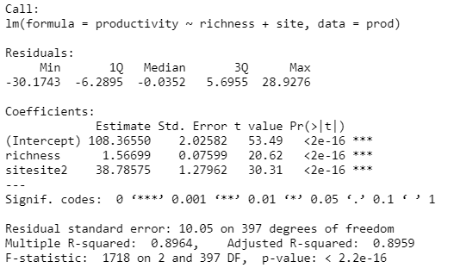
Intercept site1 = 108.4
Slope = 1.6
Intercept site2 = 108.4 + 38.8

Slide 17
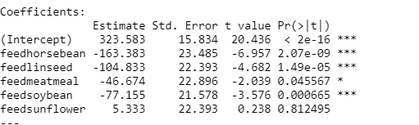
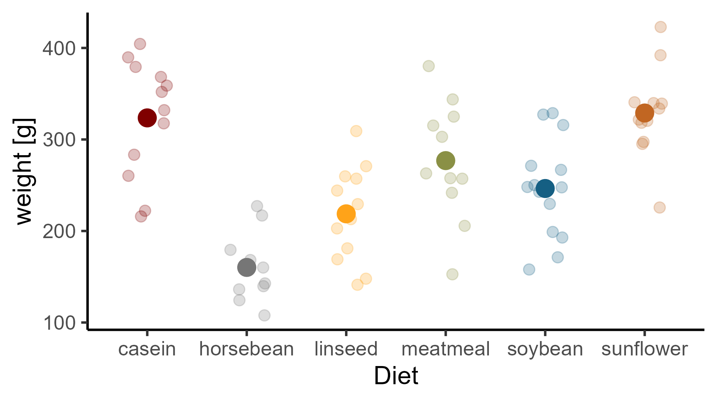

Slide 18
(Intercept) + feedlinseed
(Intercept) + feedsoybean
(Intercept)
(Intercept) + feedsunflower
(Intercept) + feedhorsebean
(Intercept) + feedmeatmeal

Slide 19
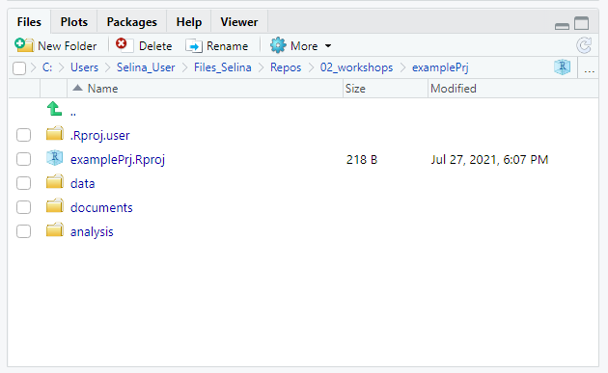
Navigate to project root
Project path
Navigate one level up
Open project in file explorer

Slide 20
Visualize
R basics
Import
Tidy
Transform
Communicate
Model
Data analysis workflow

Slide 21

Visualize
R basics
Import
Tidy
Transform
Communicate
Model
Data analysis workflow

Slide 22
Visualize
Import
Tidy
Transform
Communicate
Model
Understand

Slide 23
Visualize
Import
Tidy
Transform
Communicate
Model
Understand

Slide 24
y
No interaction
y
Interaction
x₁
X₂
a
b
x₁

Slide 25




Slide 26
normal
distribution?
Kolmogorov-Smirnov-test, QQ-test, Shapiro-Wilk-test,..
yes
no
no
equal
variance?
F-test
Levene-test
yes
no
yes
no
equal
mean?
t-test
Welch-
test
Wilcoxon-rank- sum-test
Note:
Levine-test not necessary, if you are interested
in equal means, but not equal variances!

Slide 27
Truth
H0 is true
H0 is false
Correct decision
Probability: 1 - α
Type II error
Probability: β
Accept H0
Decision based on statistical test
Type I error
Probability: α
Correct decision
Probability: 1 – β
(Power)
Reject H0

Slide 28




Scientific idea
working hypothesis H1
and
null hypothesis H0
p: how likely would it be to observe the data if the null hypothesis was true?
unlikely (p ≤ α):
reject H0
otherwise: not not reject H0
collect data
chose level of
significance α,
test the null
hypothesis
errors possible

Slide 29
A
B
joined and sorted

